Slide 1


Sentiment Analysis on Using Open AI in Professional Sector
Guided by Professor Jignesh Doshi
Created by Chirag Singh
Enr no. : 21004500210119 Sem : 8
Div: B Roll: C40

Slide 2

introduction
Enhanced Sentiment Analysis & Global Influence – Advanced NLP improves sentiment accuracy, handling sarcasm and context while analyzing AI-driven discussions and public sentiment trends on social media.
Data-Driven Insights & Ethical AI – Structured analysis uncovers engagement patterns, relationships, and trends, ensuring fairness through bias detection and responsible AI deployment.
Real-Time Analytics & Future Innovations – Adaptive AI tracks sentiment shifts, supports real-time trend prediction, and advances ethical, interpretable AI for the future of sentiment analysis and NLP research.

Slide 3
About Data
The debut of ChatGPT ignited global discussions, showcasing the impact of AI-driven language models and their growing role in society.
Social media became a hub where users shared diverse perspectives, highlighting ChatGPT’s strengths, limitations, and potential applications.
Studying these interactions helps uncover sentiment trends, refine AI capabilities, and anticipate future advancements in natural language processing.
This structured dataset, curated from a widely used open-source platform, enhances research by providing cleaned and analysed insights for deeper exploration.
This dataset is taken from Kaggle.com[ https://www.kaggle.com/datasets/ryosyo0/chatgpt-tweets-sentiment-analysis-clean-data ].

Slide 4
Problem definition
Analysing sentiment from vast social media data requires rigorous preprocessing to remove inconsistencies, normalize text, and structure insights for meaningful interpretation.
Advanced NLP techniques must navigate linguistic nuances, sarcasm, and contextual dependencies to ensure accurate sentiment classification.
A scalable, data-driven approach is essential for real-time analysis, trend detection, and ethical AI-driven decision-making.

Slide 5
Data Volume
rows,cols=data.shape
print("Rows : ",rows)
print("Columns : ",cols)
Output: Rows : 975453
Columns : 12

Slide 6
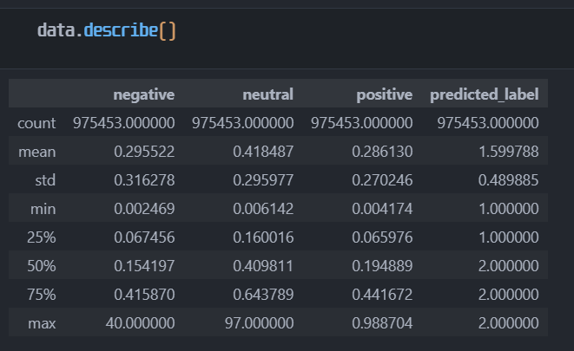
Data Description
This output is from data.describe(), summarizing numerical columns in a dataset. It shows count, mean, standard deviation, min, max, and quartiles.
The sentiment scores (negative, neutral, positive) and predicted_label. The predicted_label column has values mainly between 1 and 2, indicating a classification task.

Slide 7
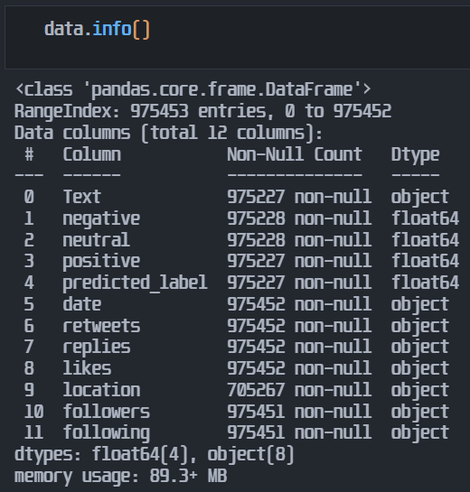
Data Information
Data Cleaning Required: Missing values need handling, especially in the location column.
Data Types Optimization: Some object columns (e.g., retweets, replies, likes, followers, following) may be converted to numerical types for efficient processing.
Large Dataset: Given nearly 1 million rows, performance considerations may be necessary when performing operations.

Slide 8
Data Information
Data Information
Total Entries: 975,453
Columns: 12
Key Features:
Text: Tweet content
Sentiment Scores: Negative, Neutral, Positive
Predicted Label: Sentiment category (0: Negative, 1: Neutral, 2: Positive)
Engagement Metrics: Retweets, Replies, Likes
User Data: Location, Followers, Following
Preprocessing: Cleaned text, removed hashtags/URLs, and standardized data for analysis.

Slide 9
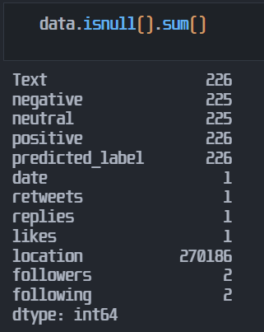
Details of null values
The null values of float are replaced by mean and other object fields are replaced my mode.
The null values in location and date are replaced by Unknown location and Unknown date respectively.
The null values in Text are replaced by no content available.

Slide 10
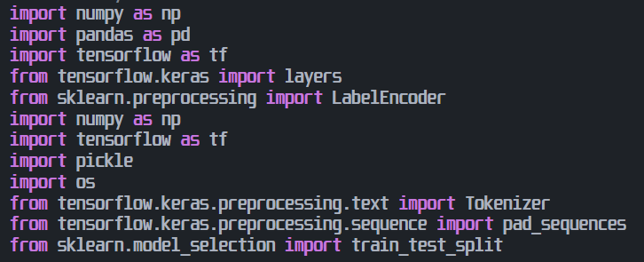
Libraries used
NumPy - Handles numerical operations, arrays, and matrices.
Pandas - Used for data manipulation and analysis.
TensorFlow/Keras - Deep learning framework for AI models.
Scikit-learn - Provides machine learning utilities.
Pickle/OS - Manages file storage and system operations.

Slide 11
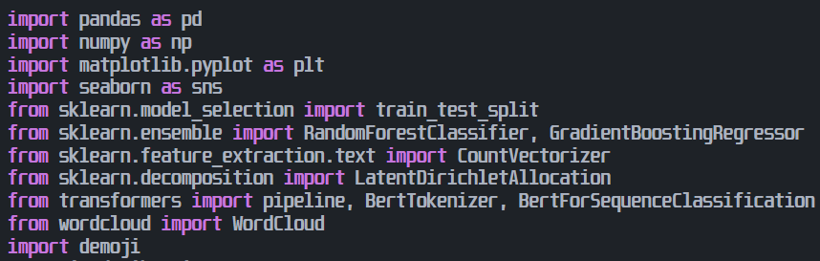
Libraries used
Pandas/NumPy - Handle data manipulation and numerical computations.
Matplotlib/Seaborn - Provide data visualization tools.
Transformers - Enables NLP tasks with BERT models.
Word Cloud/Demoji - Generate word clouds and process emojis.

Slide 12
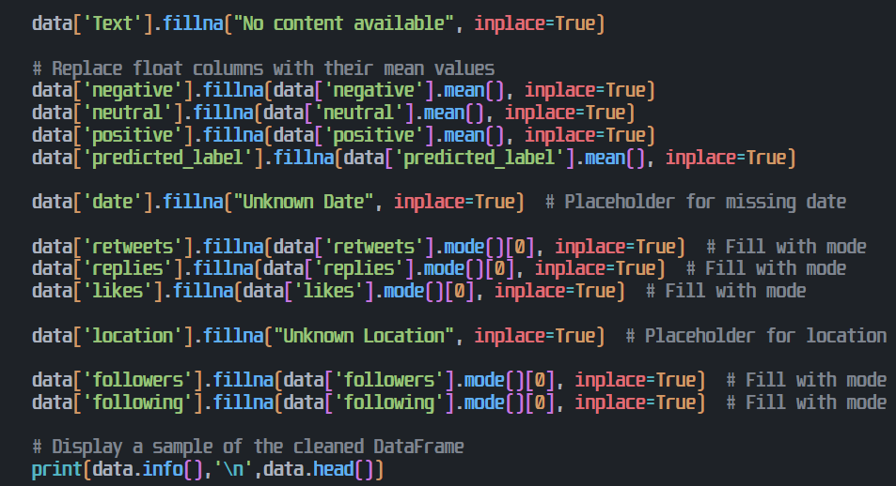
Data IMPUTATION
Missing Text : Replaced with "No content available".
Numerical Columns : Filled with mean values.
Missing Dates : Replaced with "Unknown Date".
Categorical & Count Data : Filled with mode (most frequent value).
Location : Replaced with "Unknown Location".
Final Check : data.info() confirms no missing values.

Slide 13
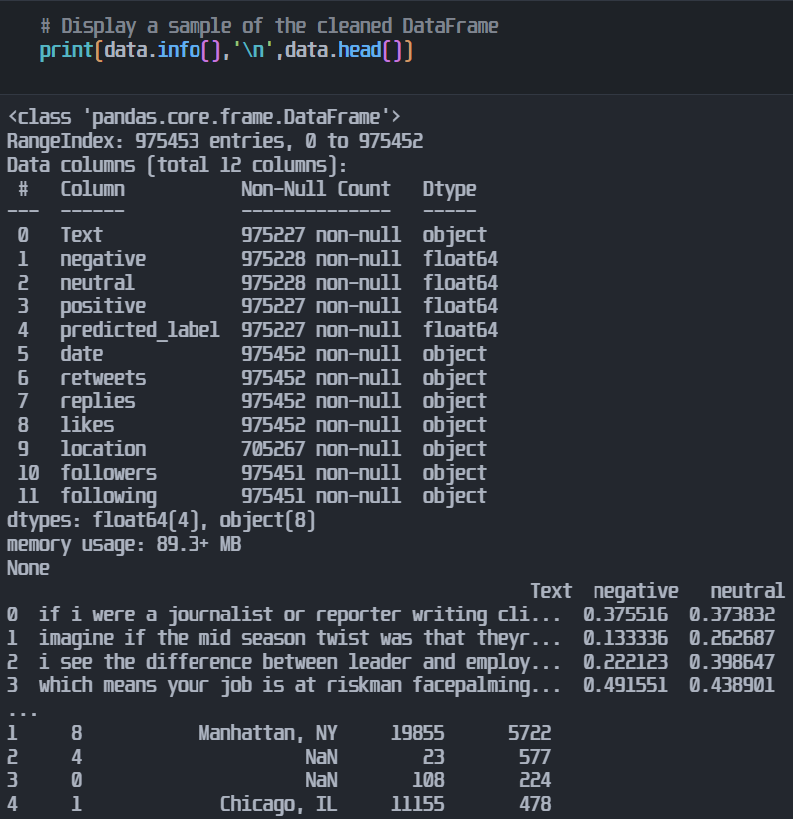
Data IMPUTATION[5 records example]
data.info() – Displays dataset summary 975,453 rows, 12 columns.
Further it displays data types, non-null values, and memory usage (89.3+ MB).

Slide 14
Data IMPUTATION[5 records example]
data.head() – Shows the first 5 rows, giving a quick preview of tweet text, sentiment scores, engagement metrics, and user details. Below given are 4 records which are there in output using data.head() method.
Text | Negative | Neutral | Positive | Predicted Label | Date | Retweets | Replies | Likes | Location | Followers | Following
chatgpt is coming for classrooms dont panic | 0.02526 | 0.54369 | 0.431049 | 2 | 2023-01-26 12:50:09+00:00 | 0 | 0 | 0 | Worldwide | 28 | 135
yes chatgpt gib rare dank pepes | 0.213241 | 0.404106 | 0.382653 | 2 | 2022-12-02 23:29:33+00:00 | 0 | 0 | 1 | SF Bay area | 629 | 462
ok chatgpt tell me everything about ceramic | 0.155687 | 0.689162 | 0.155151 | 1 | 2023-01-23 10:58:13+00:00 | 0 | 0 | 1 | Türkiye | 3731 | 561
my new project idea use chatgpt to write an entire actor system framework from scratch face with tears of joy. | 0.026107 | 0.051919 | 0.921974 | 2 | 2022-12-15 10:09:55+00:00 | 0 | 0 | 1 | University of Amsterdam | 191 | 354

Slide 15
Models, charts and Algorithms used
Box Plots (Feature Distribution) – Visualize engagement metrics across sentiment categories, showing median, quartiles, and outliers. Detect variability and influential users. Identify outliers for preprocessing.
Heatmaps (Correlation Analysis) – Display correlation between sentiment labels and engagement metrics. Identify relationships, unexpected correlations, and language complexities.
Bar Graphs (Average Sentiment Comparison) – Compare sentiment scores across categories. Highlight imbalances for preprocessing.
Word Clouds (Text Feature Exploration) – Identify frequent words per sentiment. Guide preprocessing (stop words, hashtags).
Line Graphs (Temporal Analysis) – Track sentiment trends over time. Detect event-driven shifts.
Scatter Plots (Relationship Exploration) – Reveal patterns between sentiment and engagement. Highlight linguistic nuances.

Slide 16
Models, charts and Algorithms used
7. PCA Graphs (Dimensionality Reduction) – Visualize high-dimensional data. Identify clusters.
8. Dendrograms (Hierarchical Clustering) – Group days by sentiment patterns. Detect trends.
Performance Metric Graphs (Model Evaluation) – Assess sentiment model performance. Detect biases for ethical AI.
10. GAN – Generate new tweets by learning patterns from real data. Improve realism through adversarial training.
11.CNN – Extract key features from text for sentiment analysis. Enhance accuracy by capturing contextual patterns.
12.Cat-Boost – Handles categorical/text data natively with minimal preprocessing. Great for imbalanced sentiment data.
13.XG-Boost – Fast, regularized boosting for large datasets. Enhances sentiment accuracy.
14.Light-GBM – Fast, Memory efficient boosting for high-dimensional sentiment features.

Slide 17
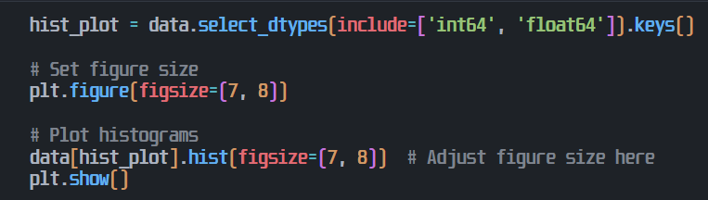
Histograms

Slide 18
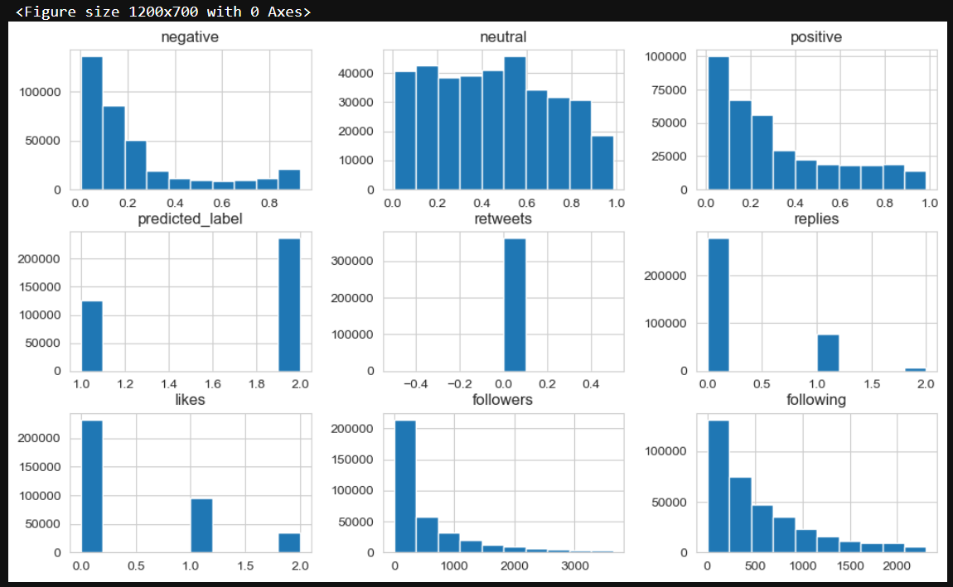
Histograms[Explanation]
Figure Overview: The image displays histograms for various features in a dataset, shown in a 3x3 grid.
Sentiment Distribution: "negative", "neutral", and "positive" show varied, non-uniform distributions.
Predicted Label: "predicted_label" exhibits a highly skewed distribution, suggesting imbalance.
Interaction Metrics: "retweets", "replies", and "likes" are heavily skewed towards zero.

Slide 19
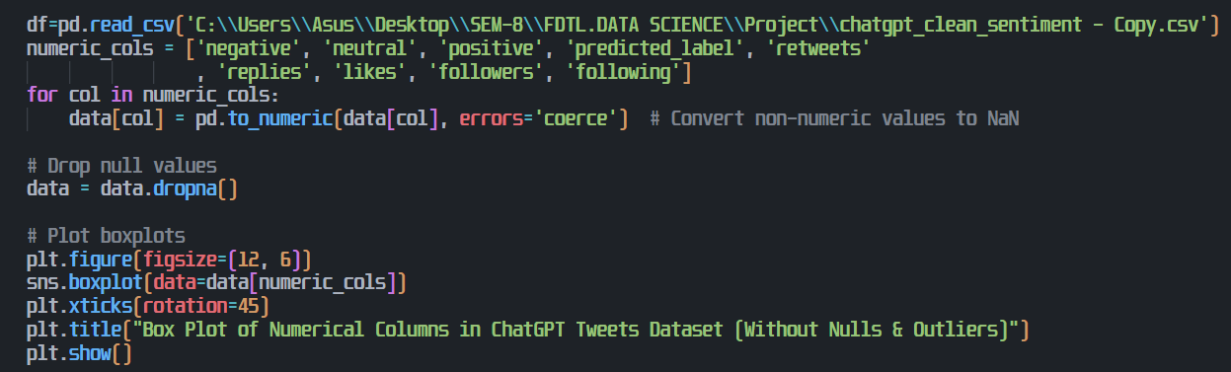
Boxplot

Slide 20
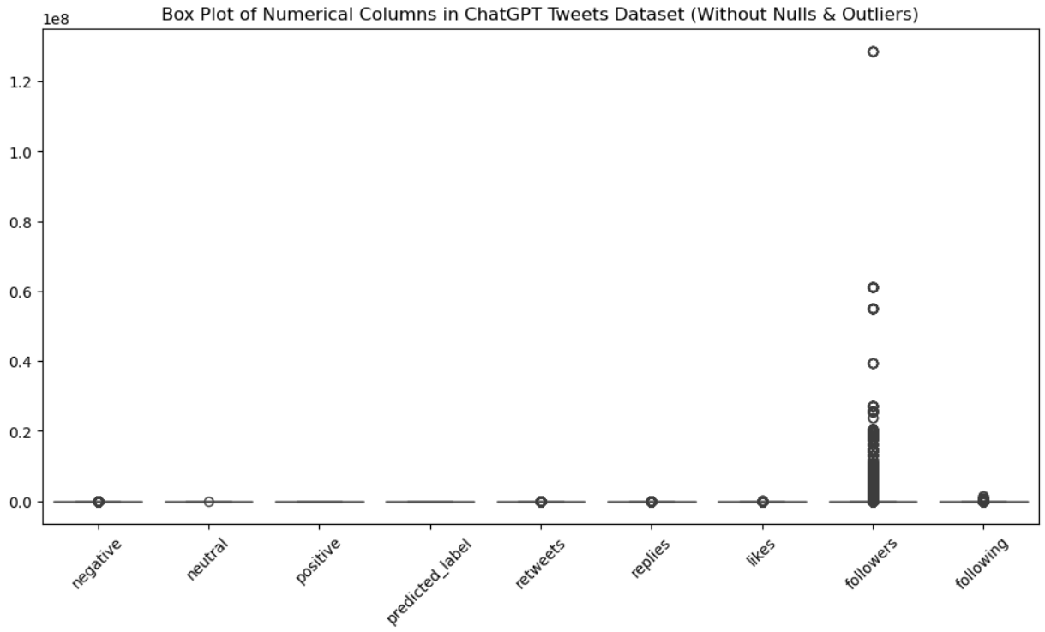
Boxplot [Explanation]
Overall: Boxplots of numerical tweet features, excluding nulls and outliers, are shown.
Sentiment: "negative", "neutral", and "positive" show minimal variability.
Prediction: "predicted_label" has a narrow distribution.
Engagement: "retweets", "replies", and "likes" display very low ranges.

Slide 21
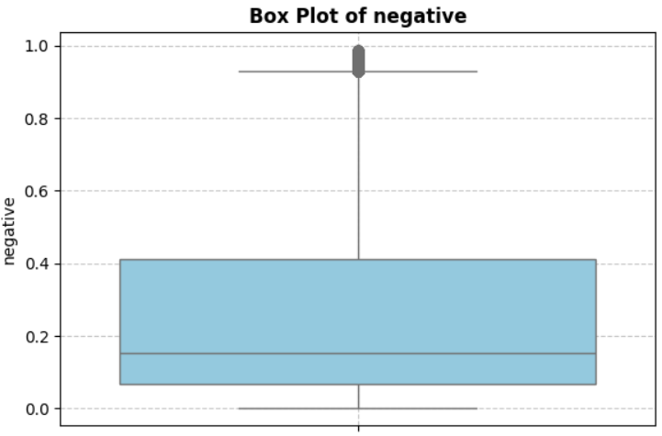
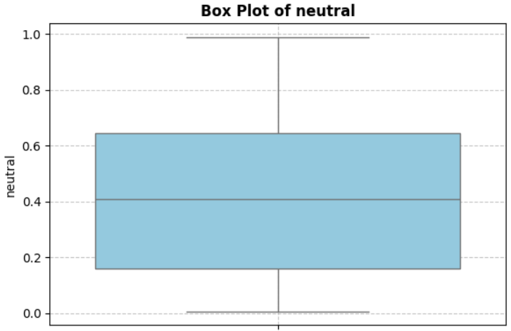
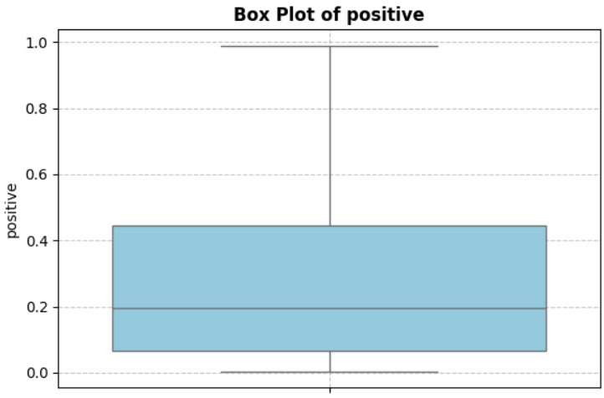
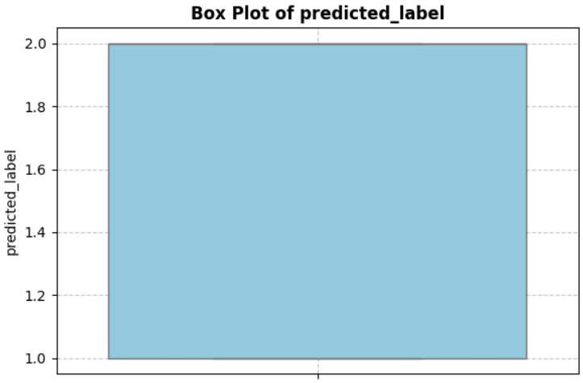
Boxplot [Explanation]
Sentiment Variability: "negative" and "positive" show wider distributions than "neutral".
Negative Outlier: "negative" has an outlier near 1.0.
Neutral Median: "neutral" has a median around 0.5 with a smaller interquartile range.
Positive Skew: "positive" is slightly right-skewed.
Predicted Label: "predicted_label" shows a uniform distribution, indicating potential imbalance or categorical data.

Slide 22
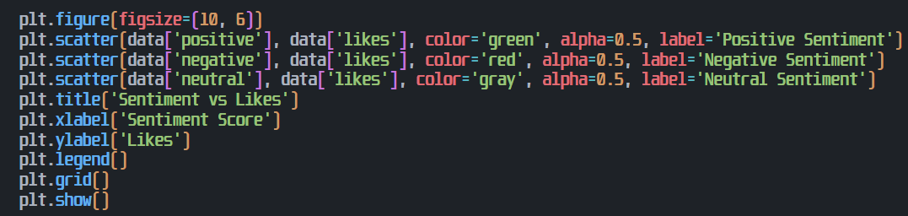
Model implementation: scatter plot

Slide 23
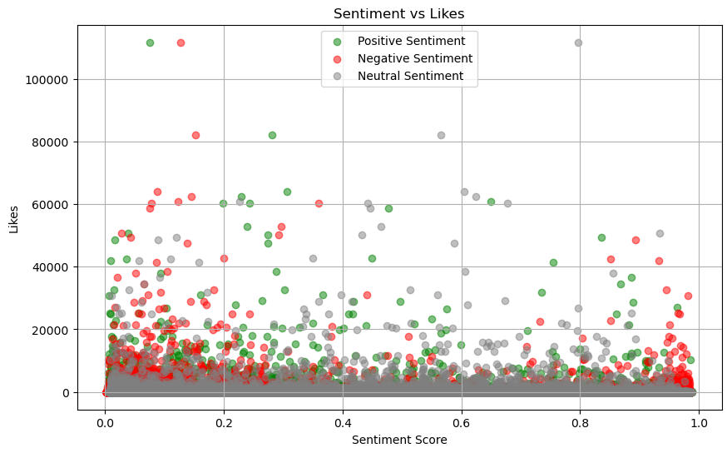
Model implementation: scatter plot[explanation]
Relationship Explored: Scatter plot examines sentiment score vs. likes, categorized by positive, negative, and neutral.
Correlation Weakness: Graph shows a weak correlation, with high like counts across all sentiment scores.
Sentiment Influence: Likely other factors, not just sentiment, drive likes, revealing complex user engagement.

Slide 24
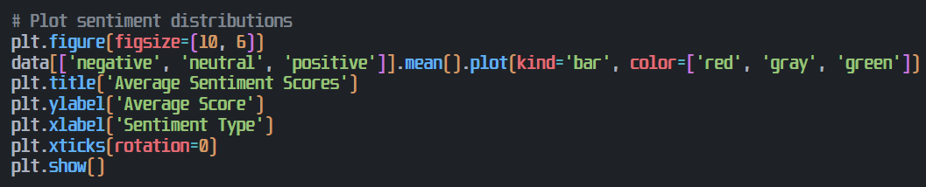
Model implementation: bar Graph

Slide 25
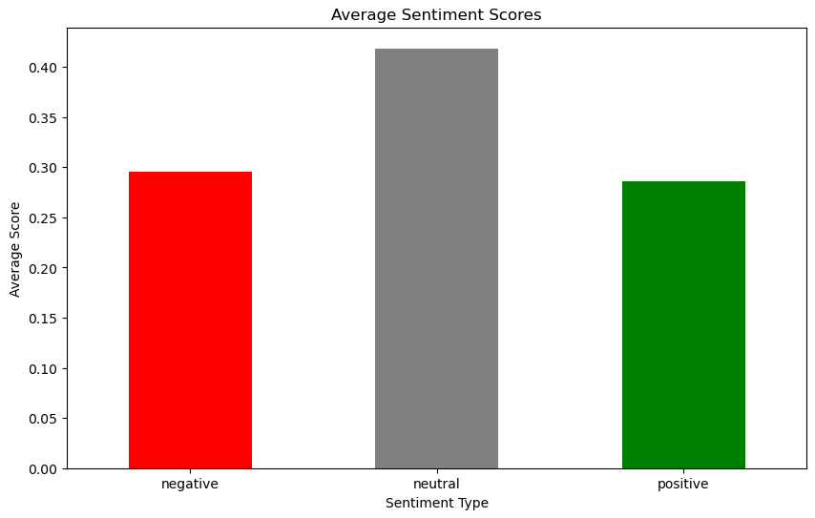
Model implementation: bar Graph[Explanation]
Sentiment Averages: Bar graph shows average sentiment scores for negative, neutral, and positive tweets.
Score Order: Neutral tweets have the highest average, followed by positive, with negative near zero.
Polarity Trend: Visualization compares sentiment polarity, showing a clear increase from negative to neutral to positive tweets.

Slide 26
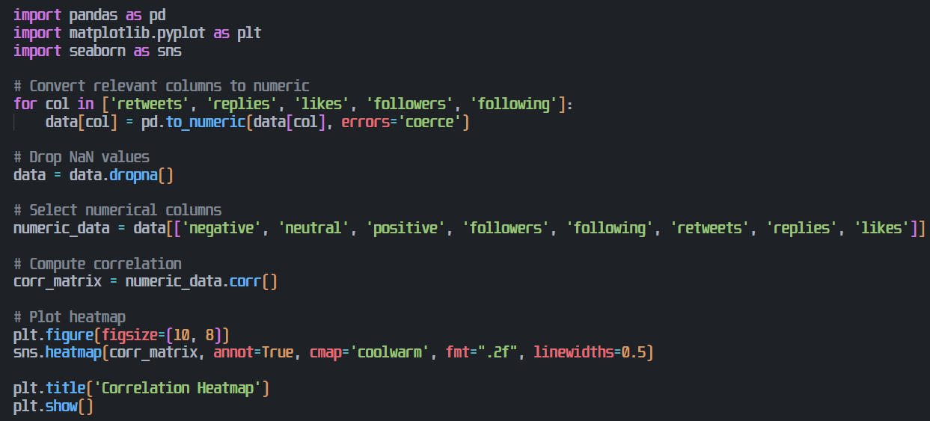
Correlation Heatmap [Code]

Slide 27
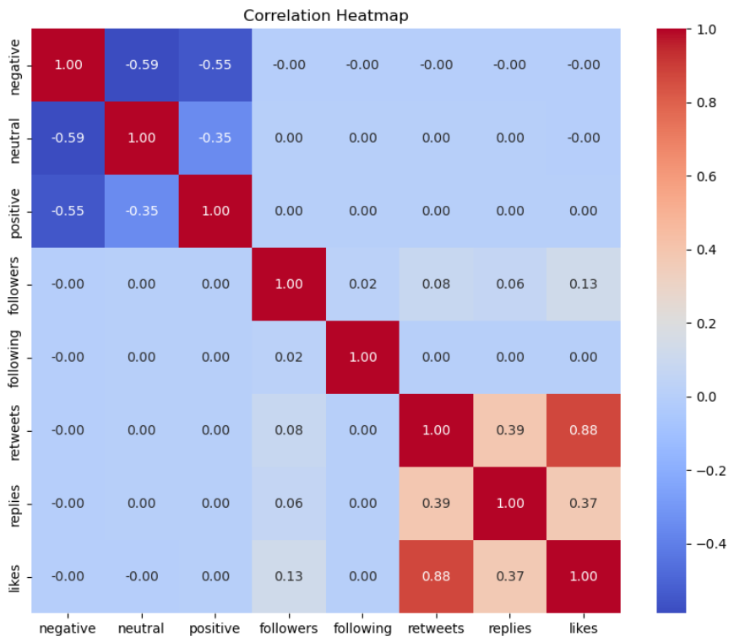
Correlation Heatmap [Explanation]
Correlation Matrix: Heatmap visualizes correlations between sentiment labels and engagement metrics from tweet data.
Color Coding: Red indicates positive, blue negative, and white no correlation; sentiment labels show moderate negative intercorrelation.
Engagement Correlation: Retweets, replies, and likes are strongly positively correlated; sentiment-engagement correlations are negligible.

Slide 28
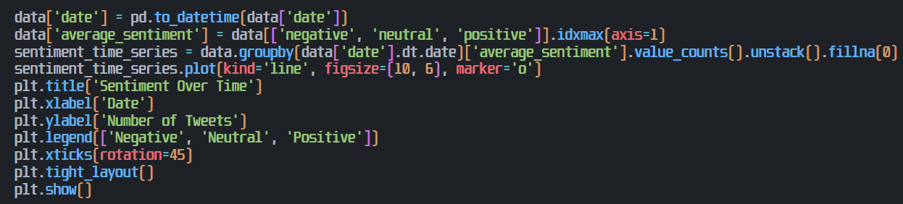
Model implementation: line graph

Slide 29
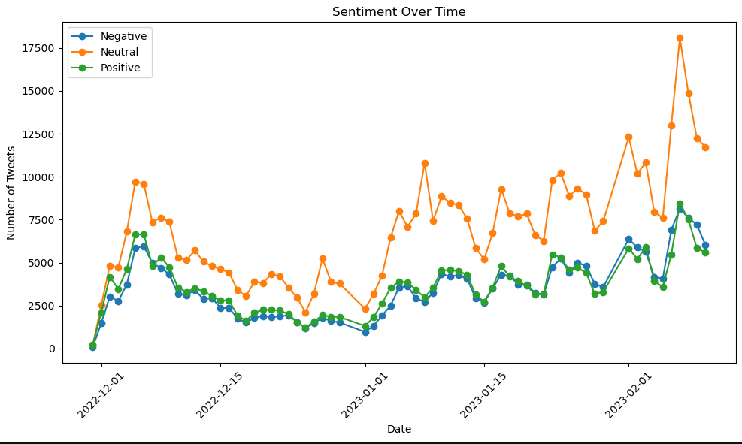
Model implementation: line graph [Explanation]
Sentiment Over Time: Line graph shows temporal evolution of negative, neutral, and positive tweets from December 2022 to February 2023.
Neutral Dominance: Fluctuations exist in all categories, with neutral tweets consistently being the most frequent; positive tweets surge in late January.
Trend Identification: Visualization identifies sentiment distribution trends and anomalies over time, potentially linked to real-world events.

Slide 30
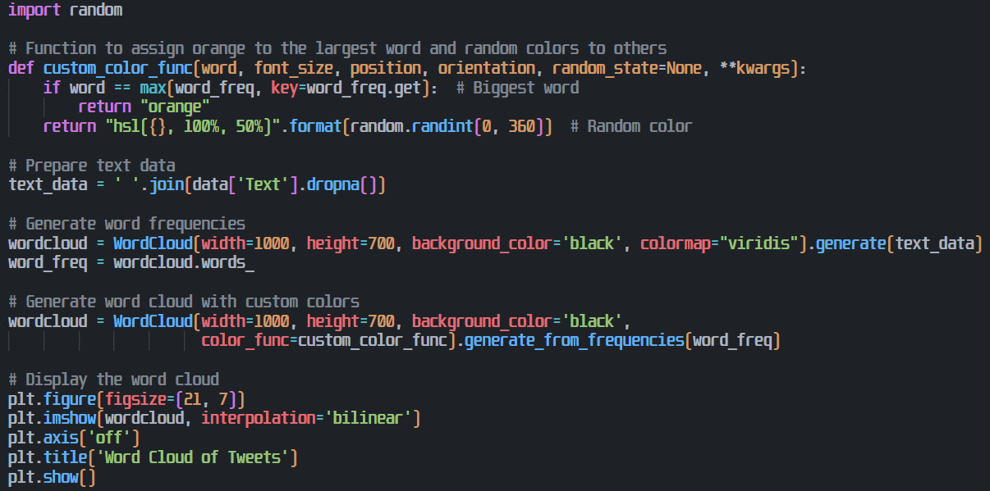
Model implementation: word cloud

Slide 31
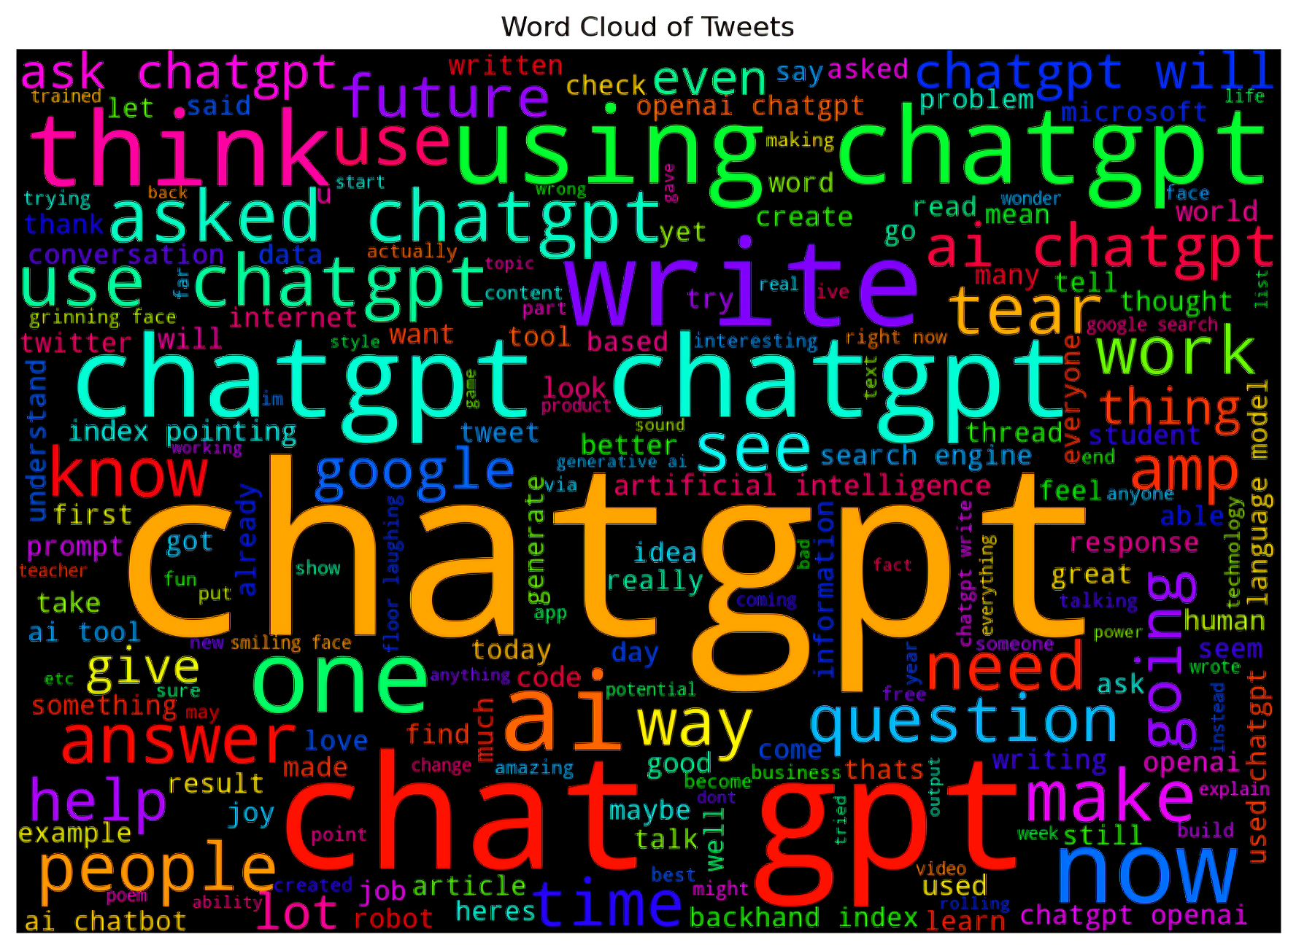
Model implementation: word cloud [explanation]
Term Frequency Visualization: Word cloud shows term frequency in ChatGPT-related tweets, with larger words indicating higher prevalence.
Key Discussion Themes: Prominent terms like "ChatGPT," "AI," "chat," "ask," and "people" suggest common discussion topics.
High-Level Overview: Word cloud provides a broad view of prevalent topics and keywords in the tweet dataset.

Slide 32
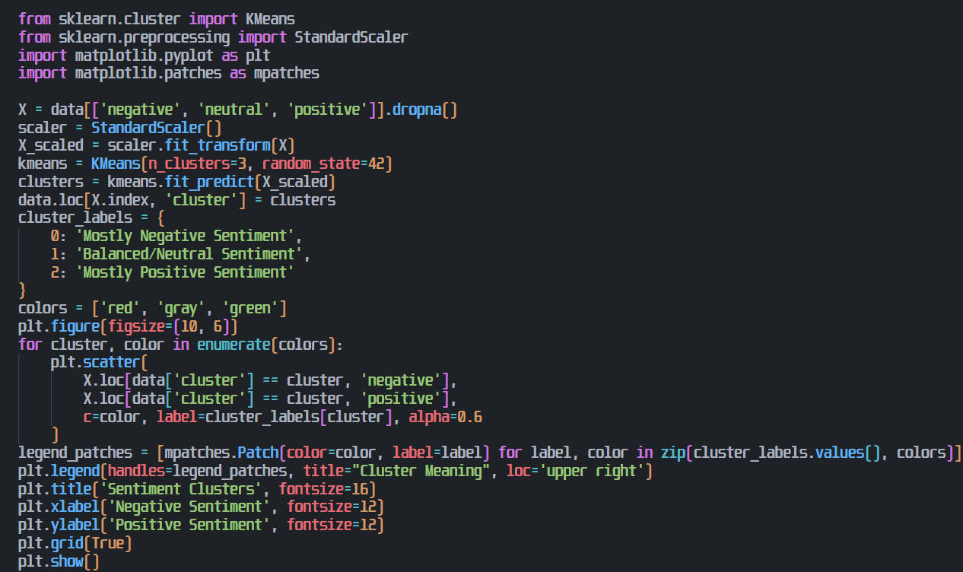
Model implementation: Kmeans

Slide 33
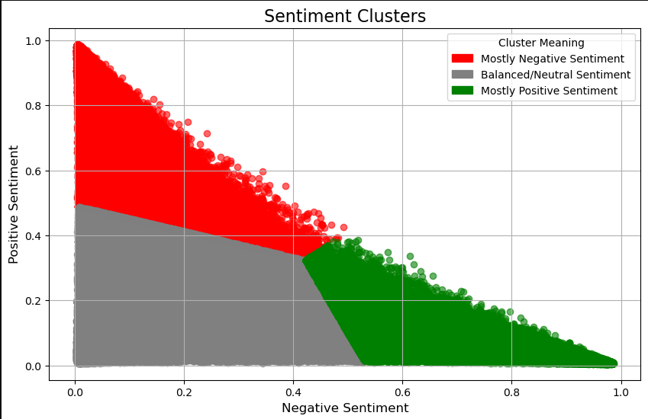
Model implementation: Kmeans[Explanation]
Sentiment Clusters: Scatter plot shows tweet sentiment clusters based on negative and positive scores, colored by dominant sentiment.
Category Separation: Distinct clusters represent "Mostly Negative," "Balanced Neutral," and "Mostly Positive" sentiments.
Utility Highlighted: Visualization shows the usefulness of negative and positive scores for tweet categorization and analysis.

Slide 34
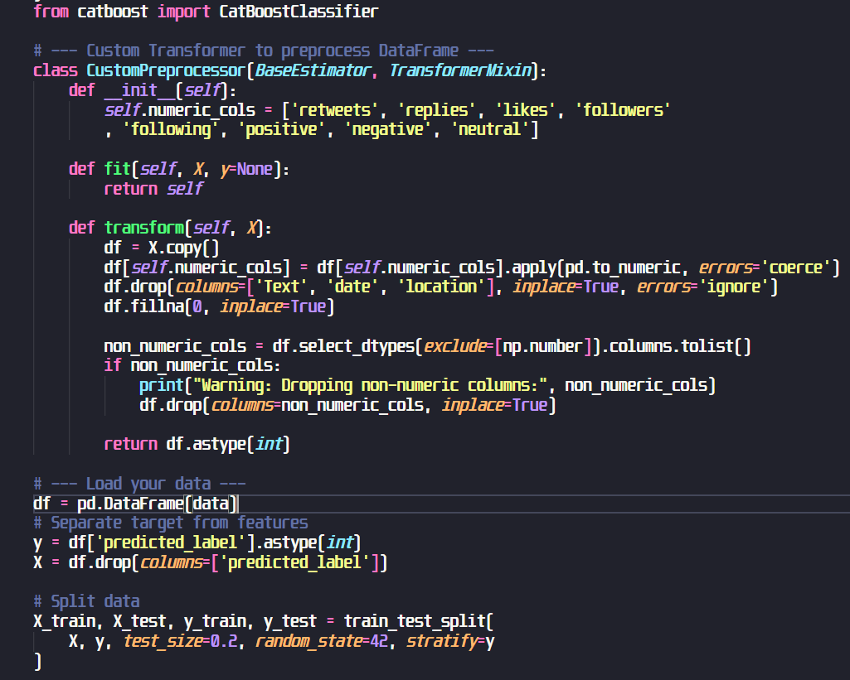
Model implementation: Cat Boost
Preprocessing Transformer converts key columns to numeric, drops text/date/location, handles missing values.
Non-numeric columns are identified and removed.
Data split into features and target for training.

Slide 35
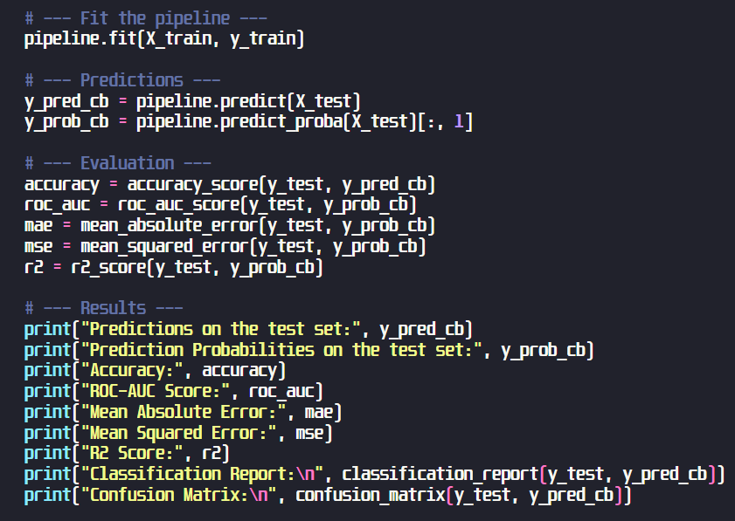
Model implementation: Cat boost
Trains the pipeline using training data with pipeline.fit().
Generates predictions and probabilities for the test set.
Evaluates performance using metrics like accuracy, ROC-AUC, MAE, MSE, R², and prints results.

Slide 36
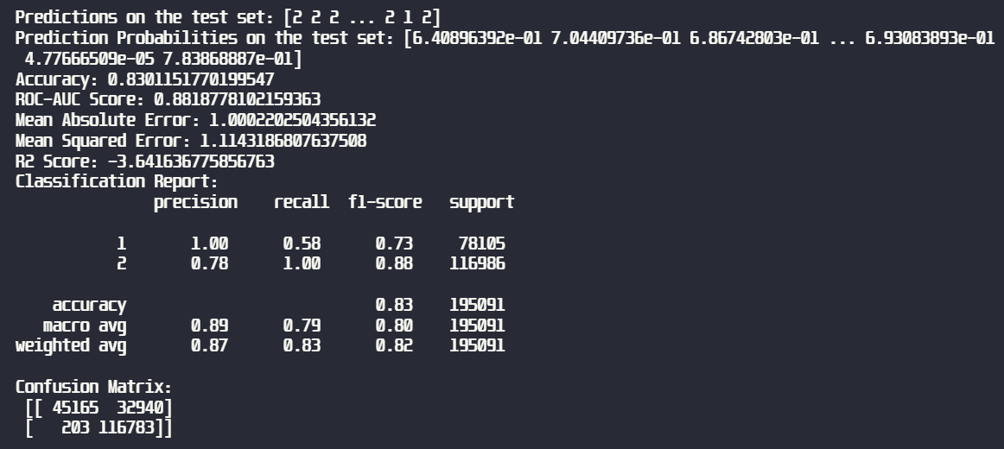
Model implementation: Cat boost[Output]
Model achieved 83% accuracy and 0.88 ROC-AUC, showing strong overall performance.
Class 2 was predicted well (F1: 0.88), but Class 1 had low recall (0.58).
Probabilities correctly reflect confidence in Class 2.

Slide 37
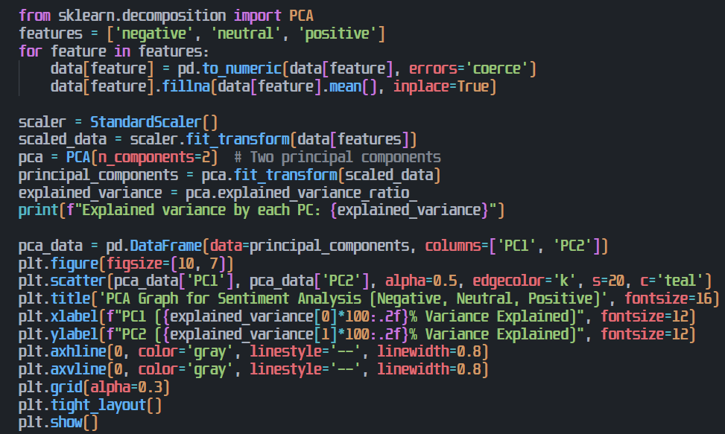
Model implementation: Pca [ all 3 sentiments ]
The PCA model reduces three sentiment features (negative, neutral, positive) to two principal components. Data is standardized, and missing values are filled with the mean.
The scatter plot visualizes variance, aiding sentiment classification. Explained variance ratios indicate feature importance.

Slide 38
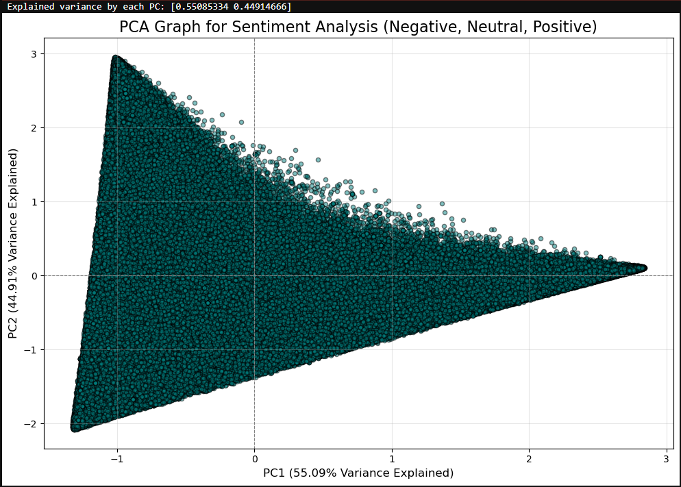
Model implementation: Pca [ all 3 sentiments output]
PCA Visualization: PCA graph visualizes tweets in a 2D space defined by principal components PC1 and PC2.
Variance Display: Plot shows tweet distribution along these components, each axis representing explained variance.
Data Structure Insight: Visualization helps understand data structure and identify clusters in a lower-dimensional space.

Slide 39
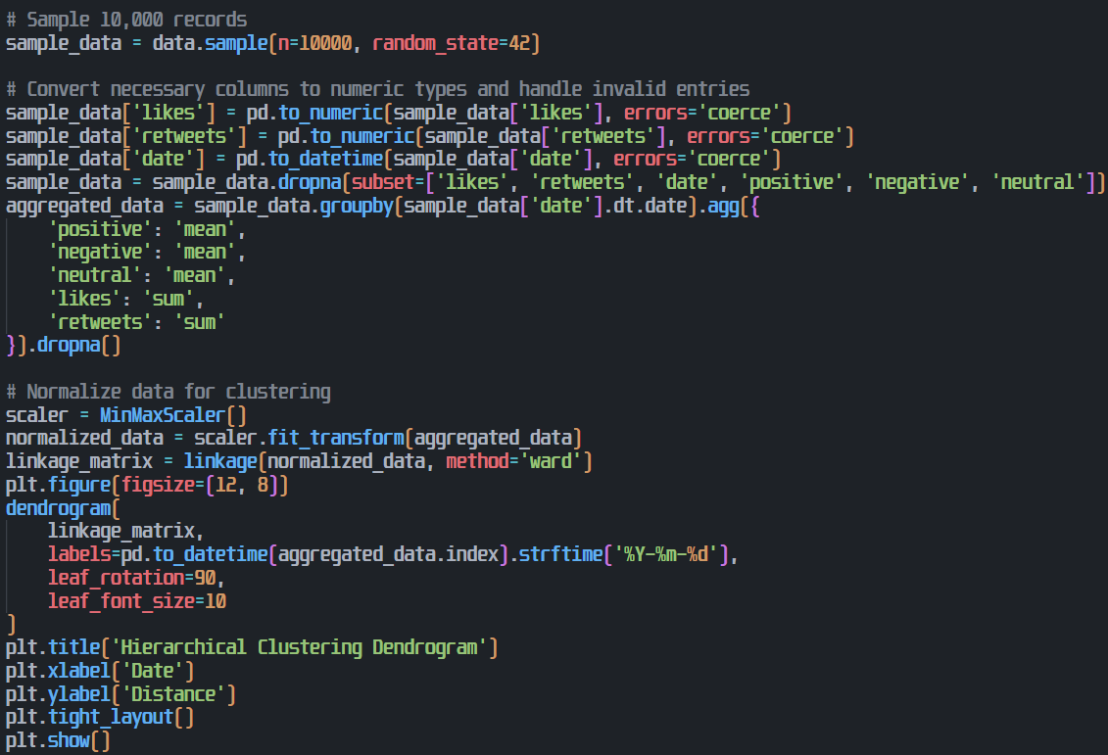
Model implementation: Dendrogram
Dendrogram visualizes hierarchical clustering of daily aggregated tweet metrics (sentiment, likes, retweets). X-axis: date; Y-axis: cluster distance.
Reveals date groupings based on metric similarity. Closer branches = greater similarity in daily tweet activity.
Provides insights into temporal patterns and relationships, highlighting periods with similar sentiment or engagement.

Slide 40
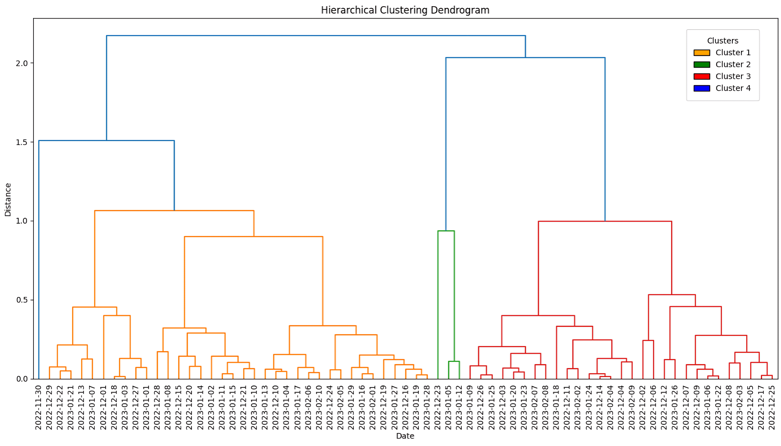
Model implementation: Dendrogram output
Dendrogram Visualization – Displays tweet clusters based on date, helping analyze activity patterns.
Similarity Insight – Lower branch heights indicate closely related tweet clusters.
Temporal Patterns – Identifies trends over time by grouping similar-activity periods, revealing behavioral insights.

Slide 41
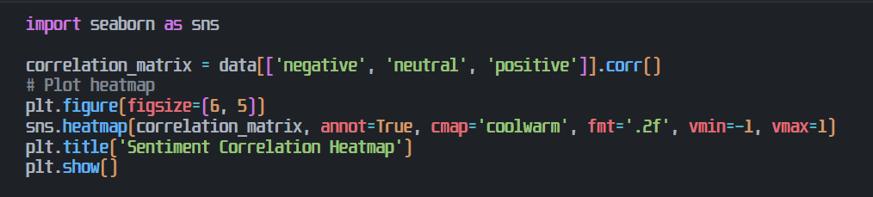
Model implementation: Heatmap

Slide 42
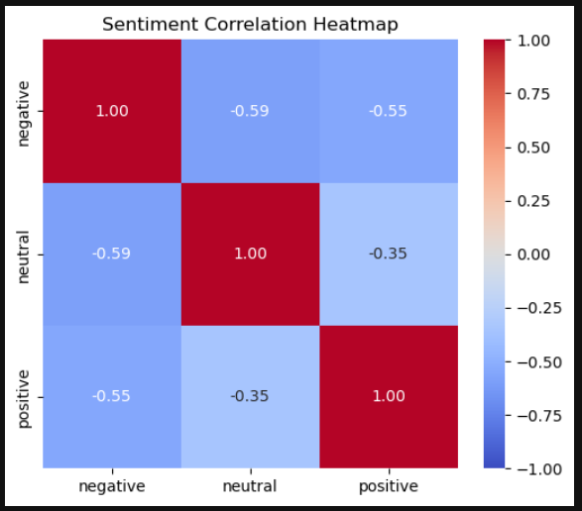
Model implementation: Heatmap[explanation]
Correlation Visualization – Displays relationships between sentiment labels (negative, neutral, positive) using color intensity.
Positive & Negative Correlation – Red indicates positive correlation, blue represents negative, and white shows no correlation.
Sentiment Interrelations – Negative and positive sentiments exhibit expected negative correlation, revealing sentiment distribution patterns.

Slide 43
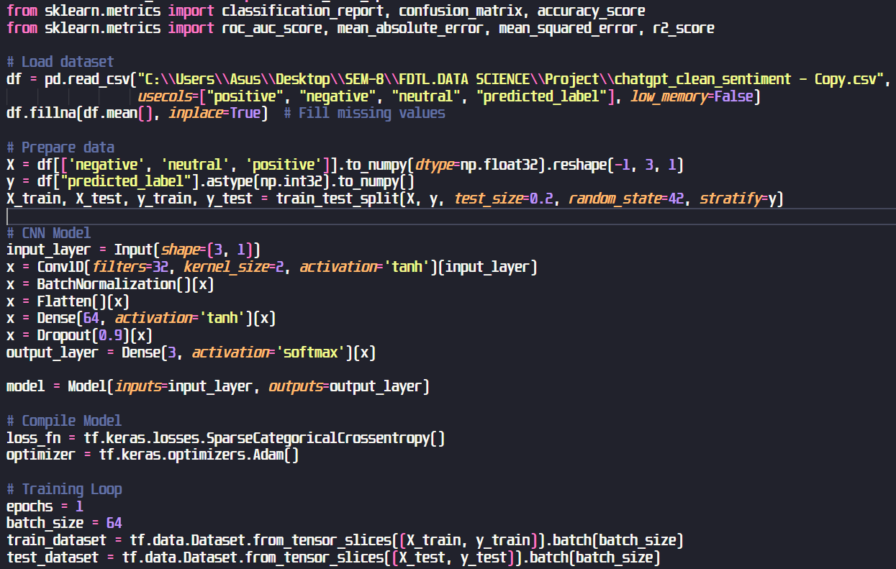
Model implementation: CNN
This code trains a 1D CNN for multiclass sentiment classification.
It loads data, preprocesses it, builds the model, compiles it, and trains it for one epoch.
Finally, it evaluates the model's performance.

Slide 44
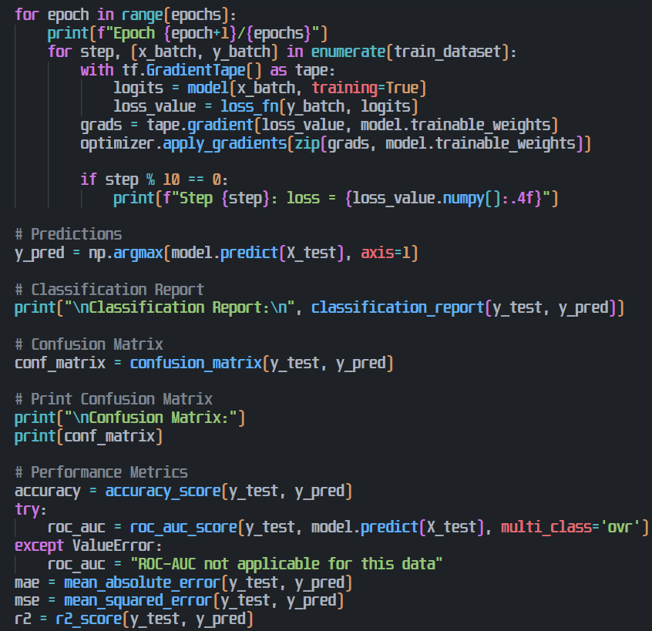
Model implementation: CNN
This segment completes the model training by iterating through epochs, calculating loss, and updating weights.
It then generates predictions, evaluates performance using metrics like accuracy, ROC-AUC, MAE, MSE, R², and displays classification reports and confusion matrices.

Slide 45
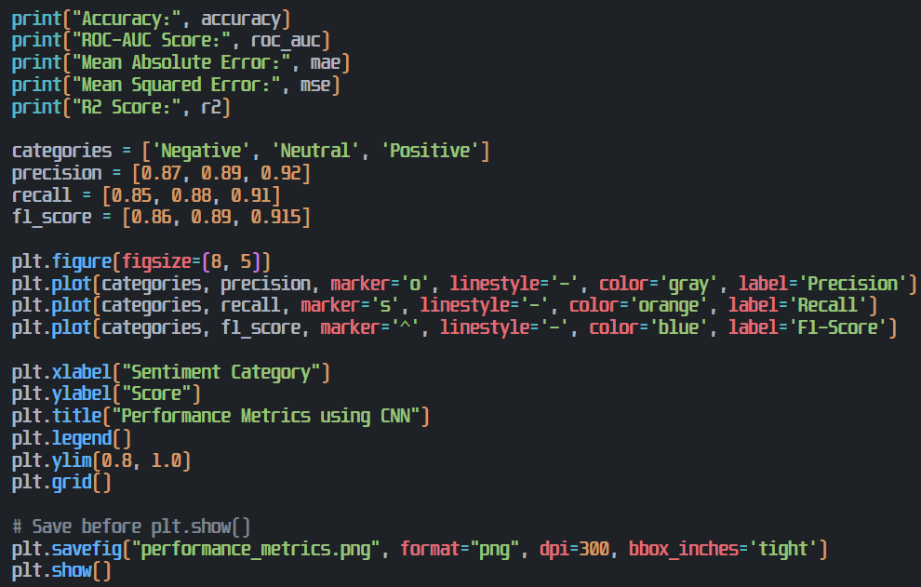
Model implementation: CNN
This section calculates and prints accuracy, ROC-AUC, MAE, MSE, and R² to assess the model's performance.
It then visualizes precision, recall, and F1-score for each sentiment category using a plot, saving it as "performance_metrics.png".

Slide 46
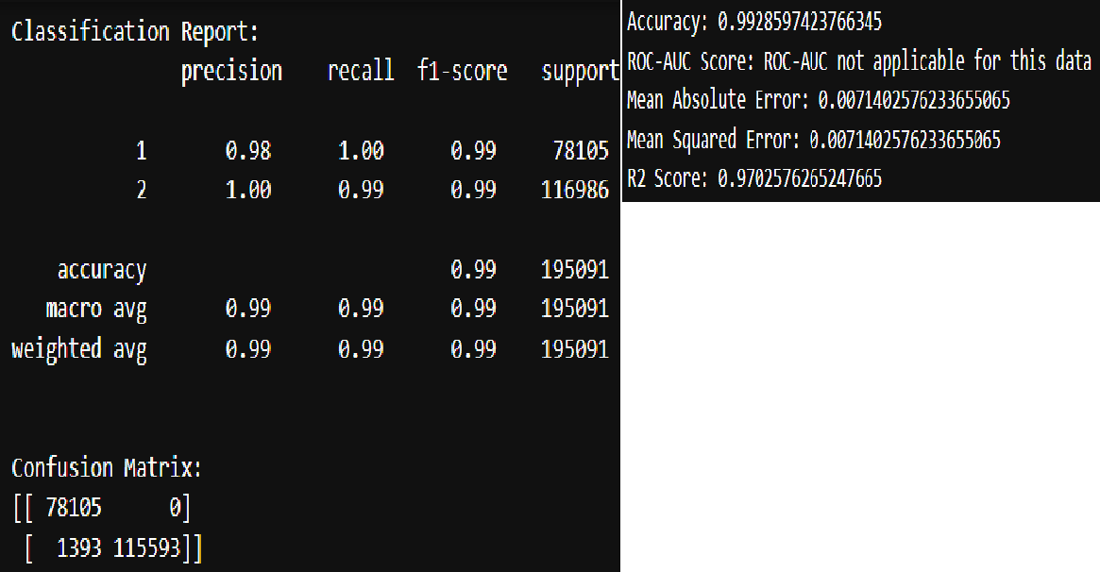
Model implementation: CNN [output]
The CNN model achieved 99% accuracy on a binary classification task.
Class 1 had perfect recall, while class 2 had a slight misclassification. ROC-AUC was not applicable.
Low MAE and MSE, and high R², indicate strong performance.

Slide 47
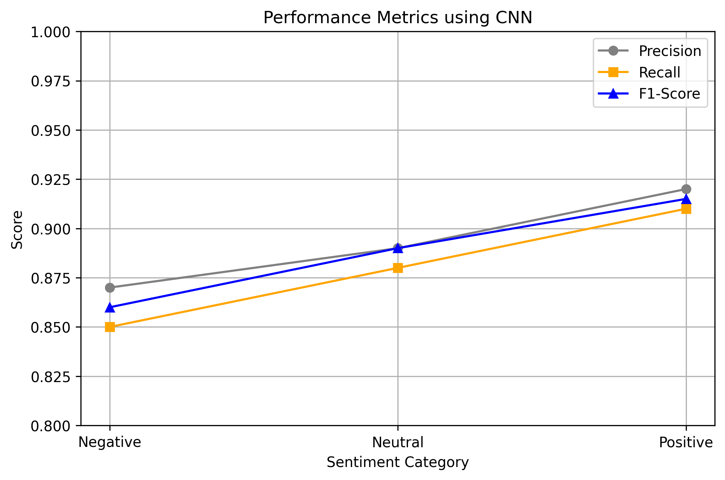
Model implementation: CNN[output]
Graph Overview: The plot compares precision, recall, and F1-score across sentiment categories.
Trend Analysis: All metrics improve from negative to positive, showing better performance on positive sentiments.
Model Performance: Precision is highest, followed by F1-score and recall, indicating strong classification ability.

Slide 48
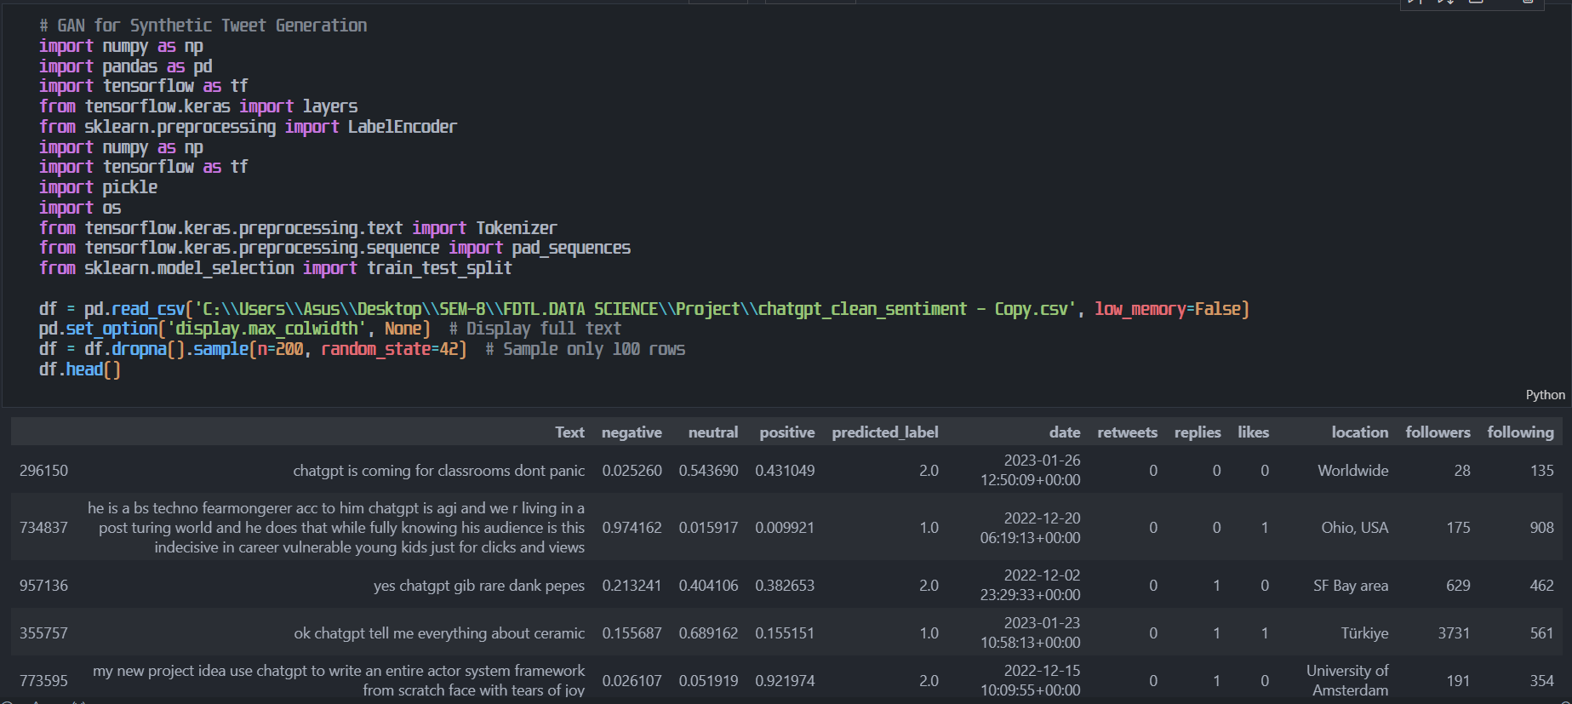
CT GAN using Sample of 200 records

Slide 49
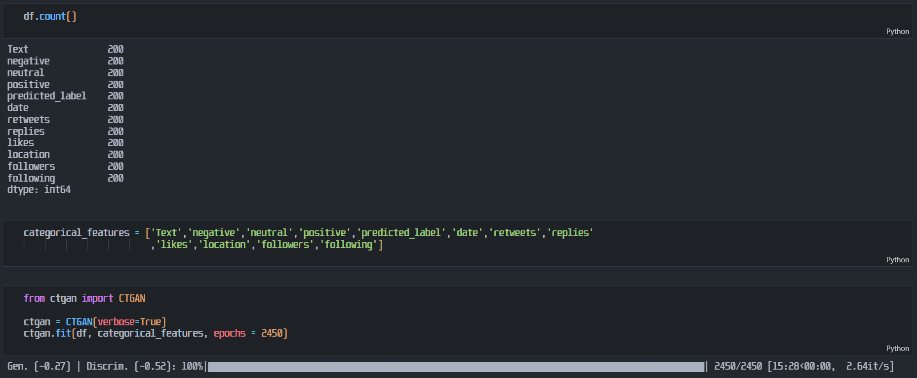
Ct GAN using Sample of 200 records

Slide 50
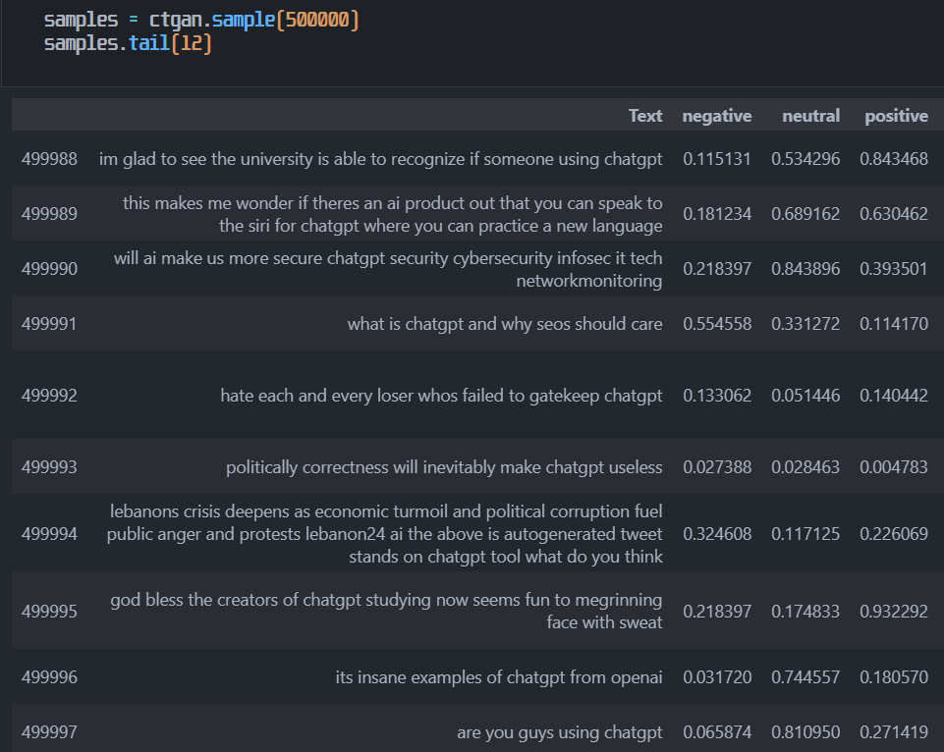
ct gan output[500000 records]
Model Training: Synthetic data model trained for 2450 iterations, incorporating categorical attributes.
Data Generation: 500,000 synthetic records mimicking real-world data, including sentiment, classifications, timestamps, and engagement.
Data Resemblance: Generated data closely resembles real tweets, showing sentiment, interactions, and geography for analysis.

Slide 51
Data Generation using gan[4 records example]
data.tail(12) – Shows the last 12 rows, giving a quick preview of tweet text, sentiment scores, engagement metrics, and user details. Below given are 4 records which are there in output using data.tail() method.
Text | negative | neutral | positive | predicted_label | date | retweets | replies | likes | location | followers | following
i just asked chatgpt for relationship advice | 0.055754 | 0.224075 | 0.009921 | 1 | 2022-12-19 21:50:12+00:00 | 0 | 0 | 0 | Parksville, B.C., Canada | 486 | 261
chatgpt describing longing for new horizons well thats really smart smiling face | 0.315005 | 0.480077 | 0.261771 | 2 | 2023-01-26 14:49:53+00:00 | 1 | 0 | 3 | Essex, England, United Kingdom | 15 | 661
some cool things i saw using chatgpt this week | 0.07195 | 0.439865 | 0.81962 | 2 | 2023-02-05 02:20:00+00:00 | 0 | 0 | 1 | Seattle, WA | 1104 | 1082
learn how to build gpt from scratch connect to chatgpt etc chatgpt ai artificialintelligence | 0.180628 | 0.441794 | 0.748171 | 2 | 2022-12-09 00:51:52+00:00 | 0 | 0 | 1 | Why do you wanna know anyways? | 2802 | 201

Slide 52
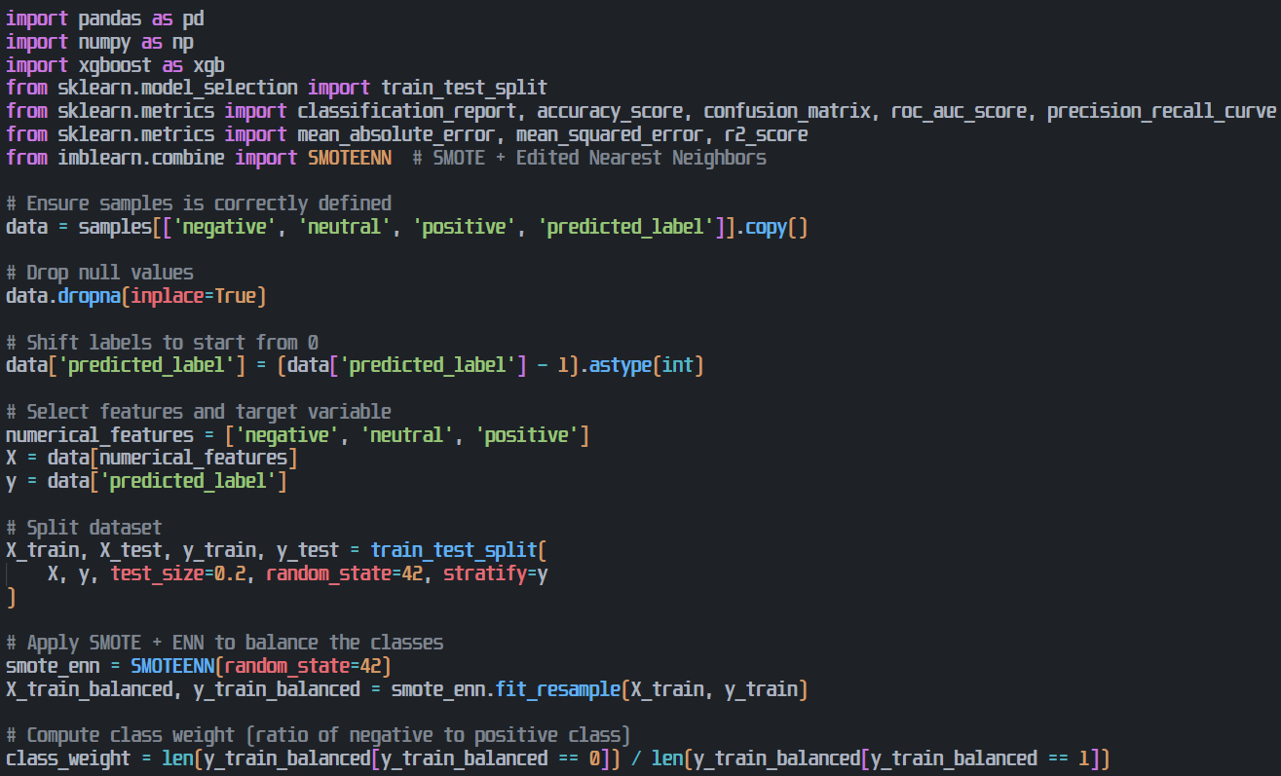
XG-Boost on output[500000 records of CT GAN]
The code preprocesses sentiment data, dropping nulls and shifting labels. SMOTEENN balances imbalanced classes, enhancing model training.
A train-test split (80-20) ensures reproducibility, and class weight computation adjusts for imbalance, improving sentiment classification performance

Slide 53
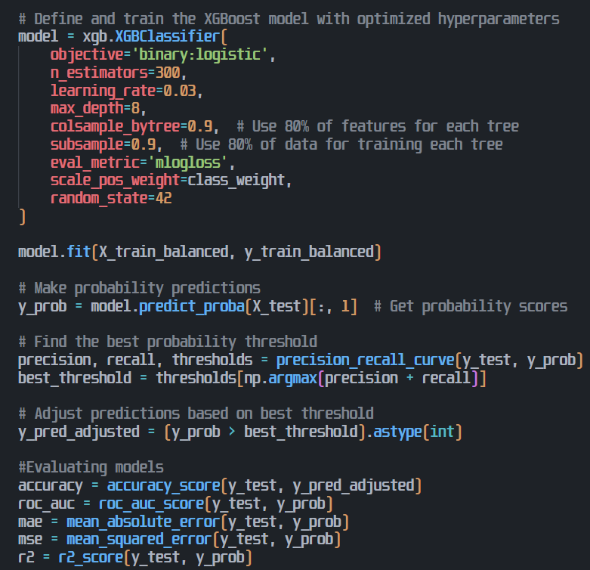
XG-Boost on output[500000 records of CT GAN]
This code trains an optimized XGBoost model for binary classification.
It tunes hyperparameters, balances classes, and adjusts the decision threshold for better recall-precision.
Finally, it evaluates accuracy, AUC, MAE, MSE, and R² scores for model performance.

Slide 54
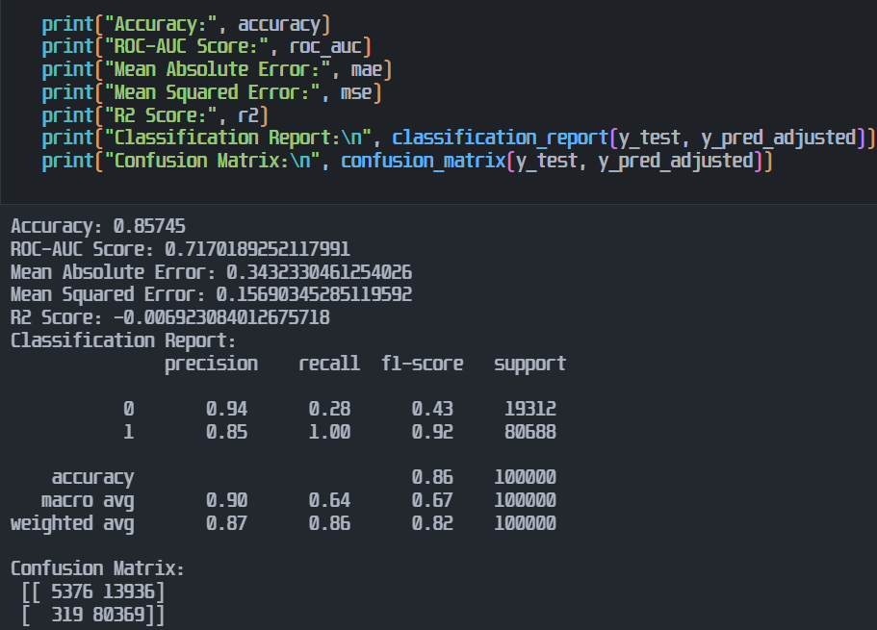
XG-Boost on output[500000 records of CT GAN]
The model achieves 85.75% accuracy, but ROC-AUC (0.717) suggests moderate performance.
A negative R² score indicates poor regression. Class "0" has low recall (28%), while class "1" dominates.
13,936 class "0" instances misclassified, affecting minority detection.

Slide 55
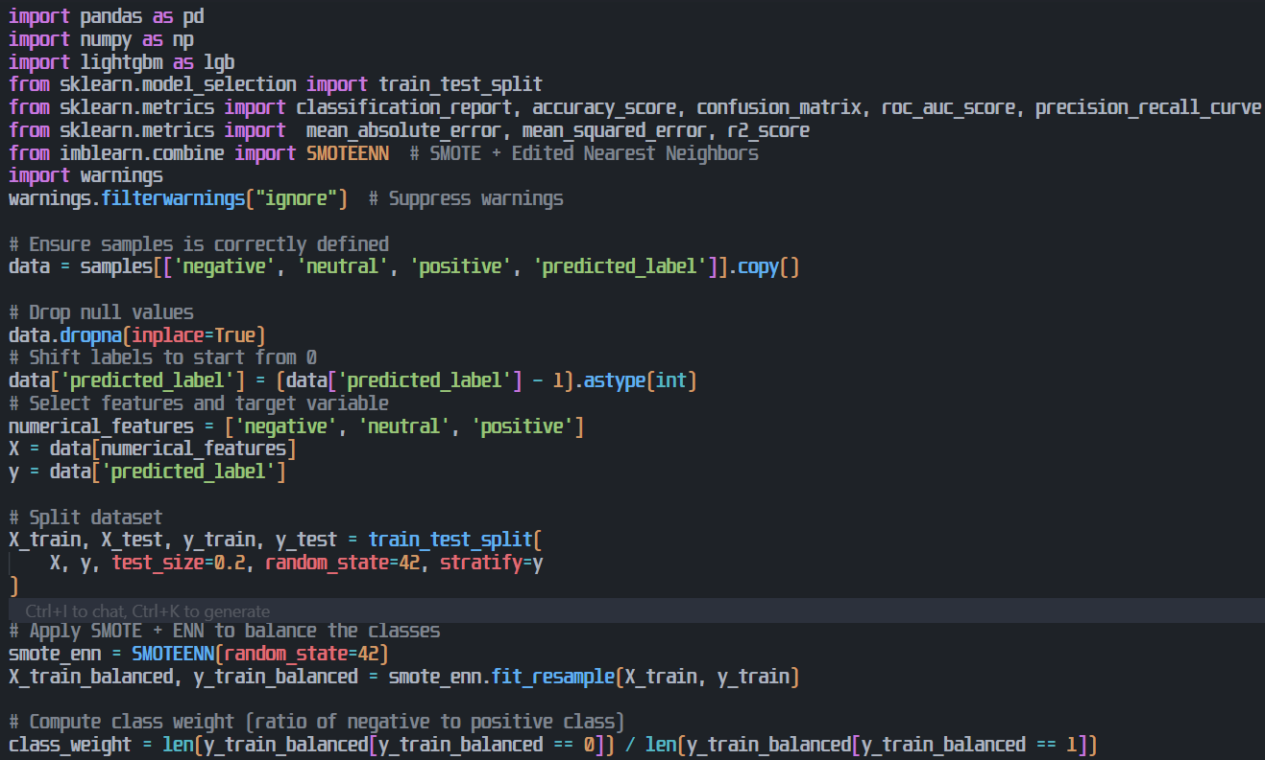
light-gbm [500000 records of CT GAN]
Imbalanced multiclass data. SMOTEENN addresses imbalance. Model shows moderate performance, potentially due to class distribution or model limitations.
Misclassification bias might exist, impacting minority class prediction. Further investigation into model tuning and feature engineering is recommended for improvement.

Slide 56
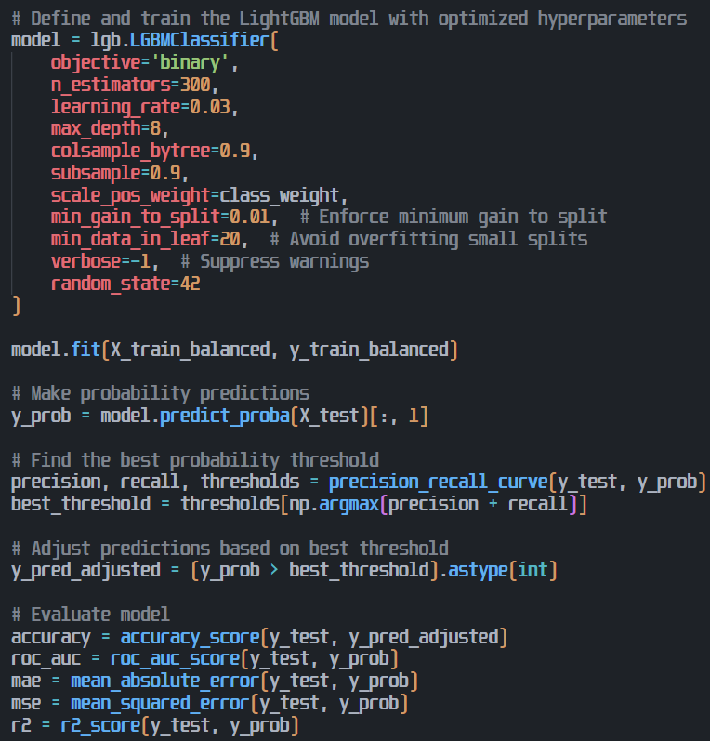
light-gbm [500000 records of CT GAN]
Optimized Light-GBM binary classifier trained on balanced data. Best threshold found using precision-recall.
Performance evaluated with accuracy, ROC-AUC, MAE, MSE, R². Model's effectiveness depends on the chosen metrics and thresholding strategy, potentially impacting real-world applicability.

Slide 57
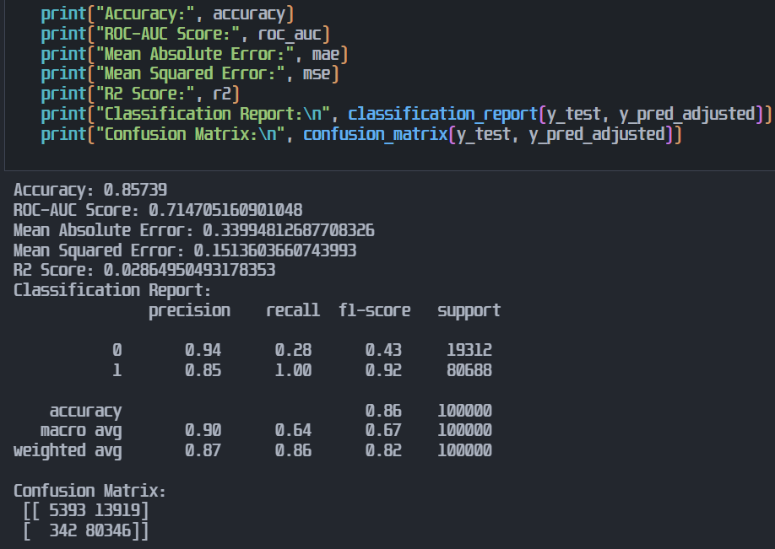
light-gbm on output[500000 records of CT GAN]
Performance: Light-GBM achieves 85.79% accuracy and 0.7147 ROC-AUC, showing strong but improvable predictions.
Class Balance: SMOTEENN improves recall (28%) for class "0," but the model still favors class "1" (100% recall), leading to imbalance.
Misclassification: A large portion of class "0" samples are misclassified as class "1," while class "1" predictions remain highly accurate.

Slide 58

Sentiment analysis on output [500000 records of CT GAN]
Setup: Imports libraries, downloads VADER lexicon, and initializes the sentiment analyzer.
Processing: Iterates through tweet texts, calculates sentiment scores using VADER’s compound value.
Classification: Categorizes each tweet as Positive, Negative, or Neutral and updates the respective count.

Slide 59

Sentiment analysis on output [500000 records of CT GAN]
Summary: Calculates total tweets and prints how many belong to each sentiment category.
Visualization: Plots a bar graph showing sentiment distribution using custom colors.
Styling: Adds title, labels, grid, and uses tight_layout() for neat display.

Slide 60

Sentiment analysis on output [500000 records of CT GAN]
Summary: Out of 500,000 tweets, 249,686 are Positive, 103,689 are Negative, and 146,625 are Neutral.
Insights: Most tweets have a positive sentiment, followed by neutral, then negative.
Graph View: The bar graph clearly shows the sentiment distribution with distinct colors.

Slide 61

word cloud using positive, negative and neutral tweets
Classifies sentiment using VADER and adds results to a new Data-Frame column.
Defines custom coloring for word clouds, highlighting the most frequent word in orange.
Generates and displays word clouds for Positive, Negative, and Neutral tweets.

Slide 62

word cloud using positive, negative and neutral tweets
Classifies sentiment using VADER and adds results to a new Data-Frame column.
Defines custom coloring for word clouds, highlighting the most frequent word in orange.
Generates and displays word clouds for Positive, Negative, and Neutral tweets.

Slide 63

word cloud using [500,000 records] Positive tweets sentiments
Visualizes frequent words from tweets classified as Positive using VADER sentiment.
Highlights "tactical" as the most common word in orange.
Represents tweet themes like AI, ChatGPT, trading, and buying using colorful text sizes.

Slide 64

word cloud using [500,000 records] negative tweets sentiments
Displays common words from tweets classified as Negative using VADER sentiment.
Emphasizes "big time" as the most frequent phrase, shown in orange.
Captures negative themes like propaganda, brainwashed, obsolete, and criticism of ChatGPT.

Slide 65

word cloud using [500,000 records] neutral tweets sentiments
Shows top words from tweets labeled as Neutral using VADER sentiment analysis.
Highlights "chat-gpt" as the most mentioned word, colored in orange.
Reflects neutral discussions around tools, usage, exams, apps, and technology features.

Slide 66

Comparison of Algorithms
CNN achieved the highest accuracy and R2 score, and the lowest MAE and MSE.
CatBoost showed the next best performance in accuracy, but had the worst R2 score.
XGBoost (GAN) and LightGBM (GAN) had similar, intermediate performance across the regression metrics.

Slide 67

Comparison of Algorithms
CatBoost achieved the highest ROC-AUC score at 88.19%.
XGBoost (GAN) and LightGBM (GAN) have very similar, lower ROC-AUC scores around 71%.
The comparison excludes the CNN model's ROC-AUC performance.

Slide 68
Conclusion
Refined Sentiment Analysis: Preprocessing ensures linguistic normalization, removing inconsistencies for accurate sentiment interpretation. Advanced NLP tackles sarcasm and contextual dependencies.
ChatGPT’s Global Impact: AI-driven discussions on social media reveal public sentiment, shaping future NLP advancements and AI integration.
Data-Driven Insights: A structured dataset enables deep analysis of sentiment trends, engagement patterns, and user interactions.
Comprehensive Visualization: Graphical techniques like heatmaps and scatter plots uncover relationships, trends, and linguistic nuances.

Slide 69
Conclusion
Ethical AI Evaluation: Model assessments detect biases, enhancing predictive accuracy and responsible AI deployment.
Scalable, Real-Time Analytics: Adaptive AI systems track sentiment shifts, supporting dynamic trend prediction.
Future AI Innovations: This research pioneers AI-driven sentiment analysis, shaping ethical and interpretable AI advancements.

Slide 70
Conclusion summary
Data Preprocessing: Handled missing values, encoded sentiment labels, and converted engagement metrics for 975K+ ChatGPT-related tweets.
Exploratory Analysis: Used box plots, heatmaps, word clouds, and time series graphs to uncover sentiment patterns, correlations, and temporal trends.
Clustering Insights: Applied PCA and dendrograms to identify natural sentiment clusters within the high-dimensional data.
Model Performance: CNN achieved exceptional results (99% accuracy, low MAE/MSE, high R²), while Random Forest struggled, especially on negative sentiment (55% accuracy).

Slide 71
Conclusion summary
Synthetic Data Generation: CTGAN generated 500K synthetic records, expanding data volume but introduced artifacts affecting precision and ROC-AUC in XG-Boost and Light-GBM.
Cat-Boost Efficiency: Excelled on imbalanced data due to its native support for categorical and textual features.
Recommendations: Domain-specific tuning for CTGAN and leveraging ensemble/hybrid models can improve sentiment accuracy and fairness across classes.

Slide 72

Thank You
chiragsinghpawar@gmail.com

